Slide 1

WHO
Angular2 + ESRI JS 4.2 =
A world of endless possibilities
Stefan Nieuwenhuis MA

Slide 2









Allow me to introduce myself

Slide 3
Maintenance in an electric network utilities company
Time
Money
Downtime
Customer satisfaction
Danger

Slide 4

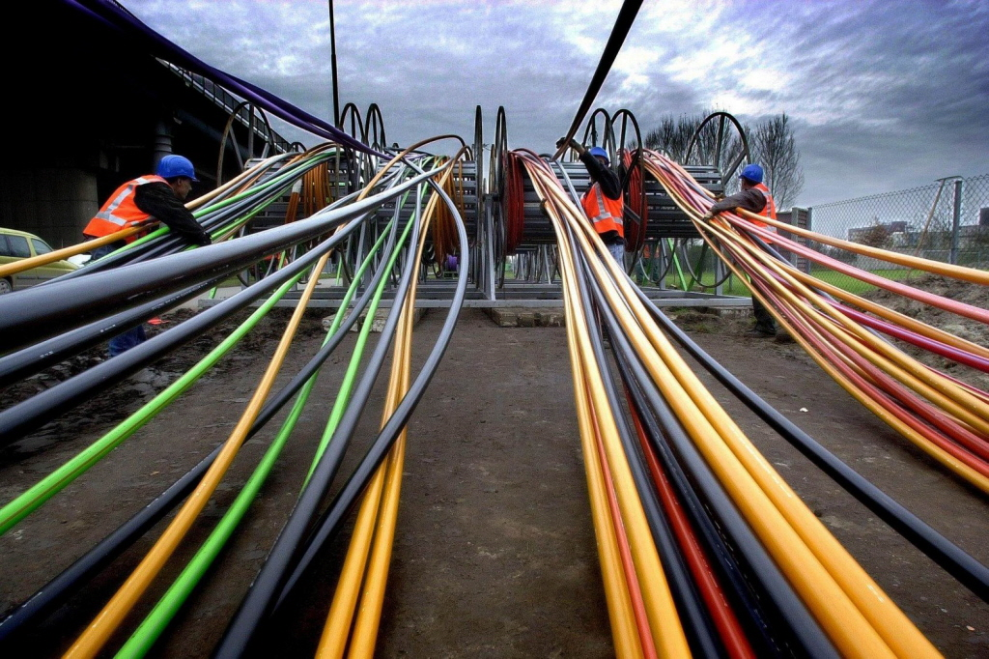
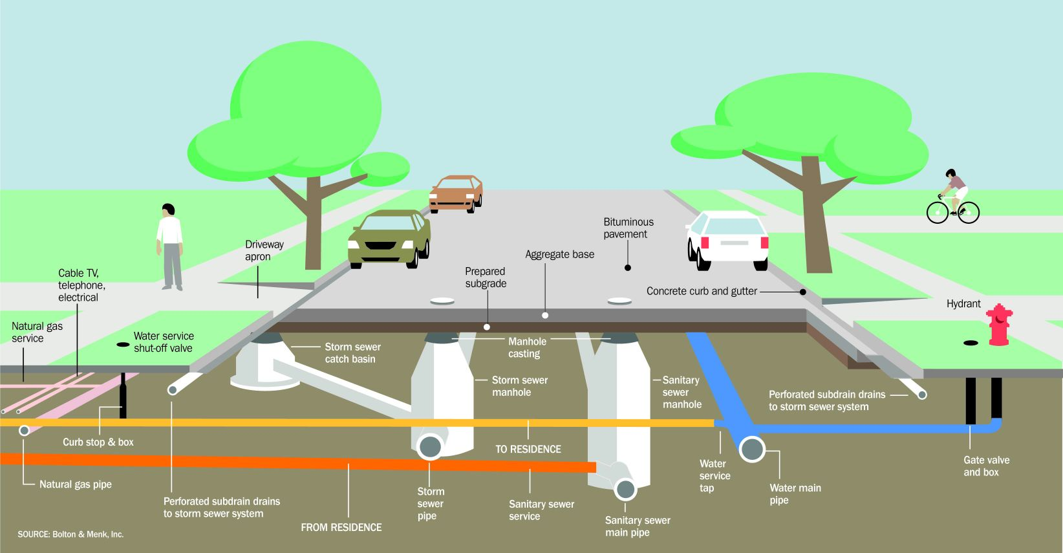
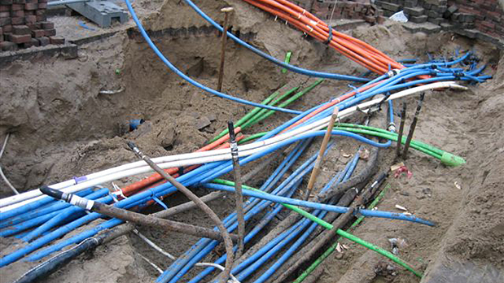
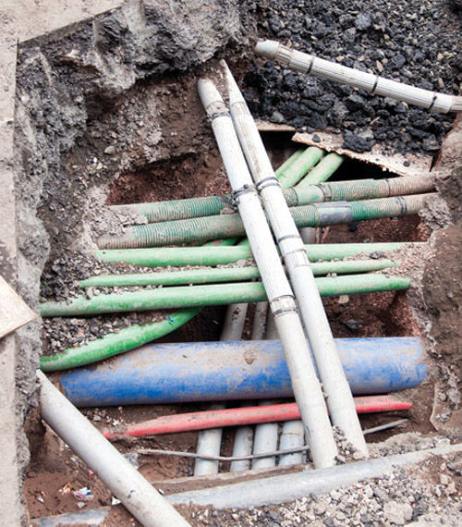
Maintenance in an electric network utilities company

Slide 5

Maintenance in an electric network utilities company

Slide 6

Maintenance in an electric network utilities company
Demographics
Power usage
Households
Location
Metadata

Slide 7

Angular 2 and ESRI Js Api 4.2
Notes:
Angular2 is the successor of Angular 1.x
It’s not just a newer version, but it’s totally rewritten
In combination with TypeScript it’s completely Object Orientated similiar to languages like C# and Java
It’s a component based framework (a tree of loosely coupled components) and not following the MVC architecture

Slide 8
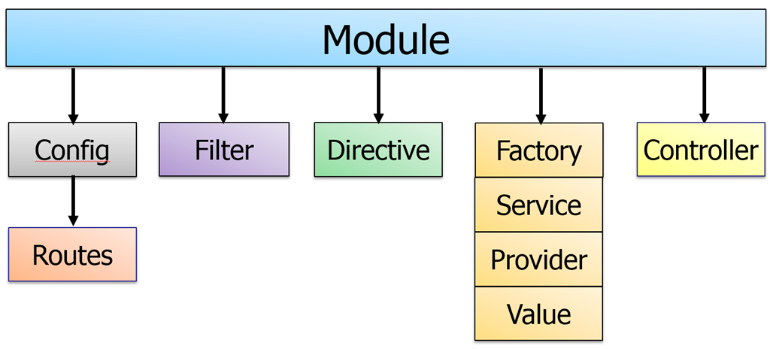
Angular 2 and ESRI Js Api 4.2

Slide 9
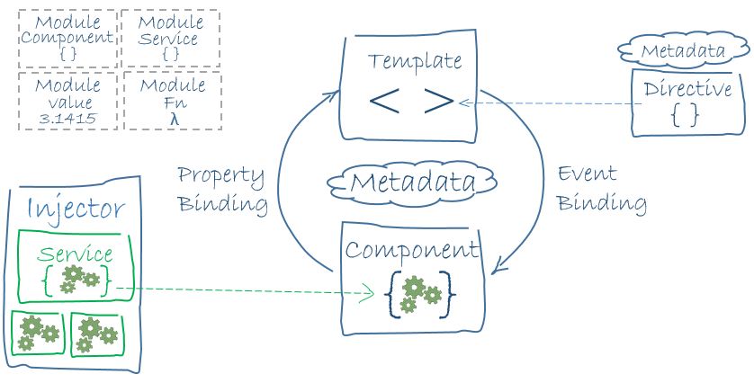
Angular 2 and ESRI Js Api 4.2

Slide 10
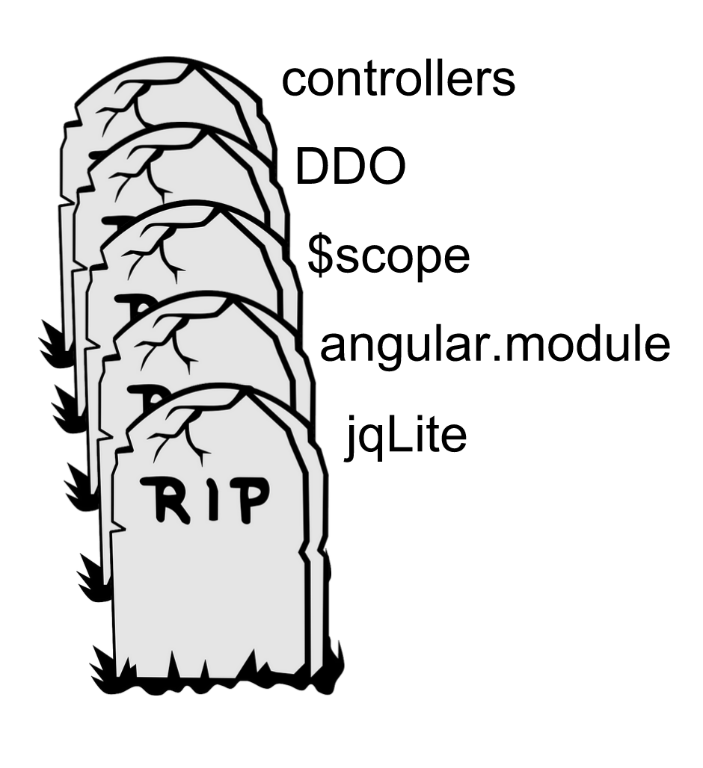
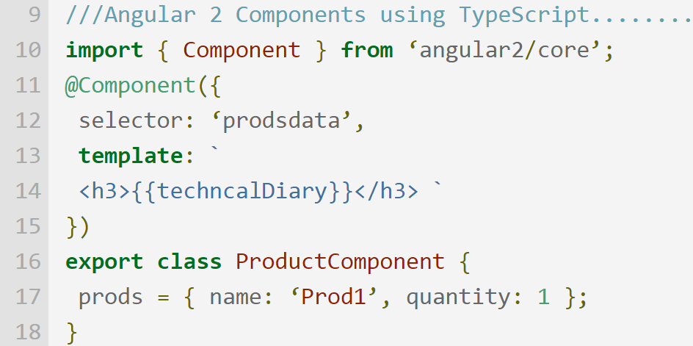
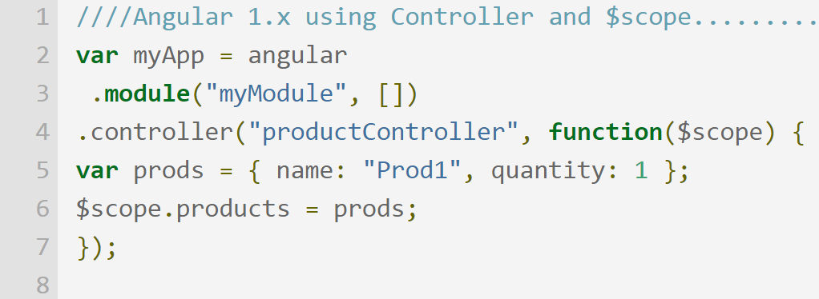
Angular 2 and ESRI Js Api 4.2

Slide 11
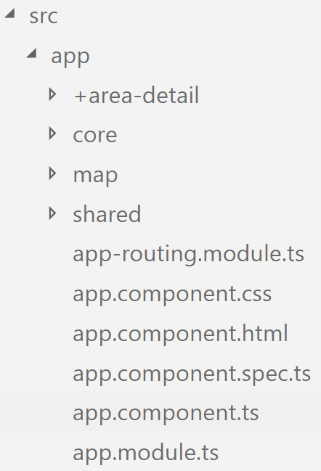
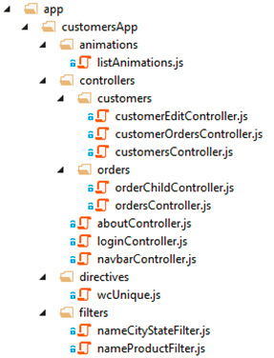
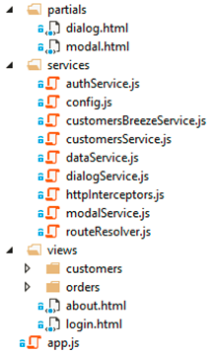
Angular 2 and ESRI Js Api 4.2

Slide 12
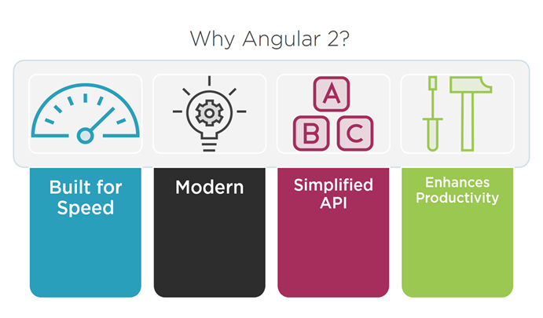
Angular 2 and ESRI Js Api 4.2

Slide 13

Angular 2 and ESRI Js Api 4.2
Notes:
Dojo has it’s own implementation of the AMD stack and therefore not compatible with Webpack and Angular2.
So we need a workaround, an external loader to load ESRI modules into non-DOJO apps.
Tom Wayson developed a npm-module called esri-loader which does the trick.

Slide 14
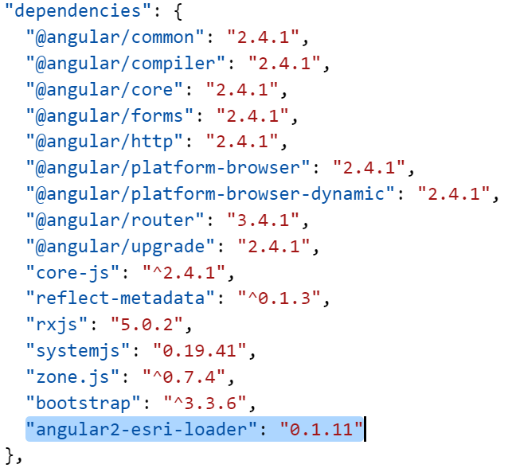
Angular 2 and ESRI Js Api 4.2

Slide 15
Angular 2 and ESRI Js Api 4.2

Slide 16
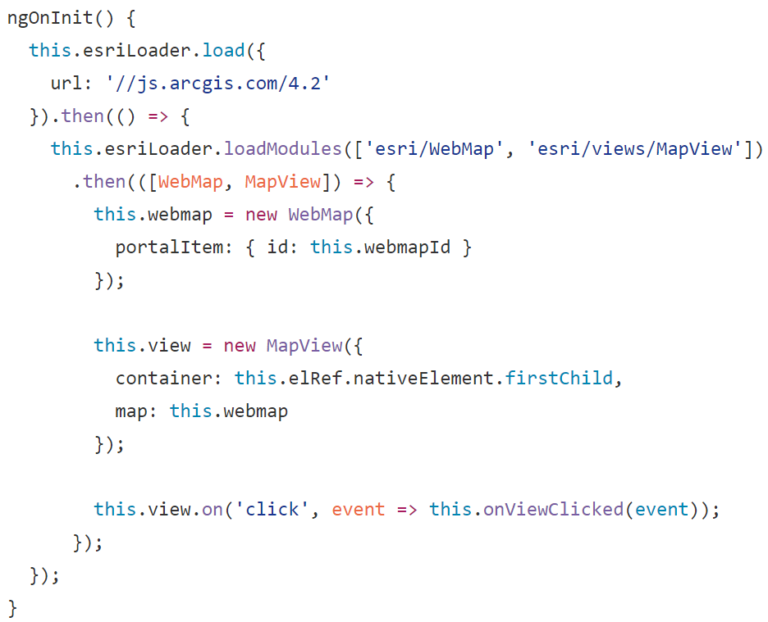
Angular 2 and ESRI Js Api 4.2

Slide 17
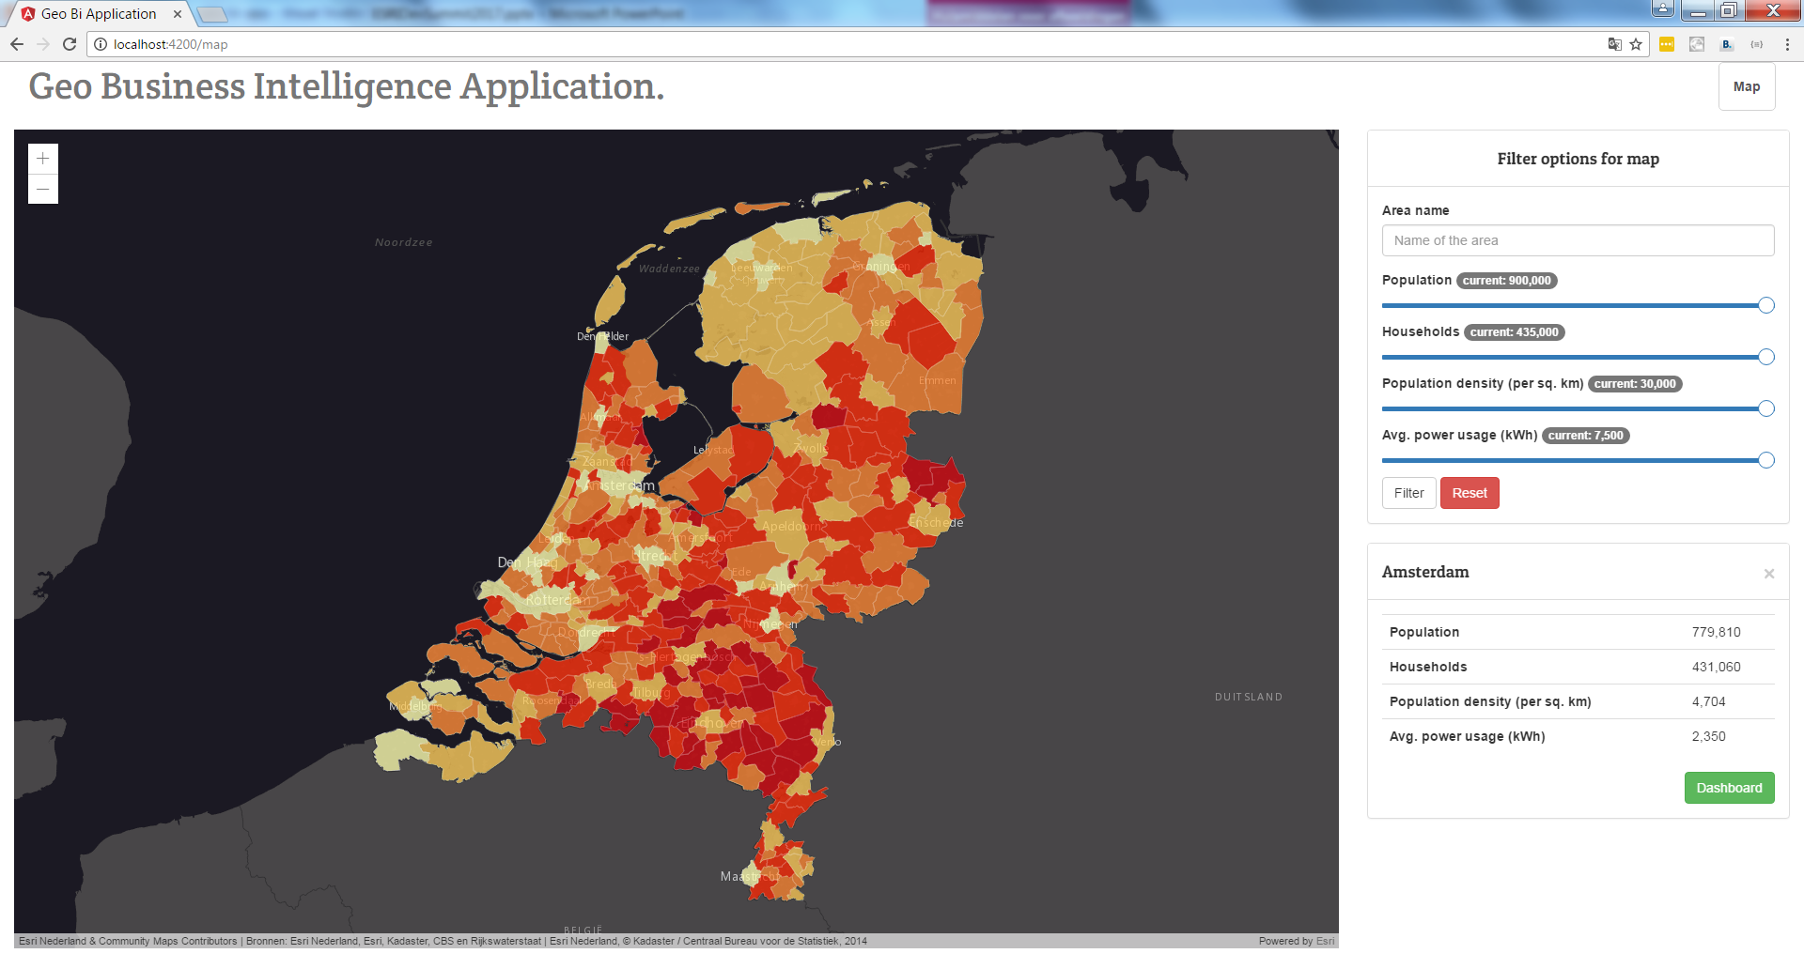

The Geo Bi Application
Geo Business Intelligence Tool

Slide 18
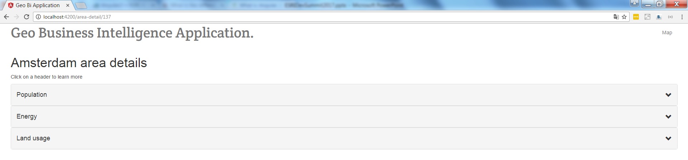
The Geo Bi Application

Slide 19
The Geo Bi Application
app
map
area-detail
map-view
map-filter
map-detail
core
nav
accordion

Slide 20
The Geo Bi Application
Angular2
Frontend
NodeJs + Express Api
ArcGis Server
AGS Online

Slide 21

The road ahead
Notes:
Live maintenance monitoring
Defects/ Cable cuts
More insights

Slide 22
Lessons learned
You’ve learned about:
The maintenance process at an electric maintenance company
Angular 2
Next gen Geo BI Applications

Slide 23





Stefan Nieuwenhuis MA
Stefan.Nieuwenhuis@ordina.nl
+31 (0)6 10 21 99 73
linkedin.com/in/stefannhs
github.com/StefanNieuwenhuis
Notes:
Conclusion
With the Geo Bi Application net managers are capable to get the right insights to plan maintenance in a effictive way
Clay tablets belong to the past
Developing with Angular2 is a great relief. Especially when you’re used working with vanilla JS and Angular 1.x
Angular2 and Dojo isn’t a great combination
The future is literally a world of endless possibilities

